Slide 1
Software Design and Architecture
Introduction to SDA and Architectural Thinking

Slide 2
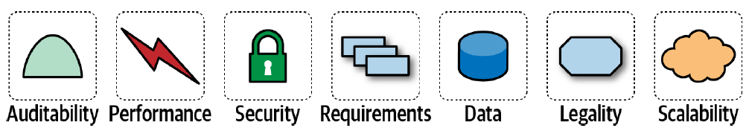
A software solution
consists of both (1) domain requirements (functional requirements) and (2) architectural characteristics (quality attributes or nonfunctional requirements)

Slide 3
An architecture characteristic meets three criteria:
Specifies a nondomain design consideration
Influences some structural aspect of the design
Is critical or important to application success

Slide 4
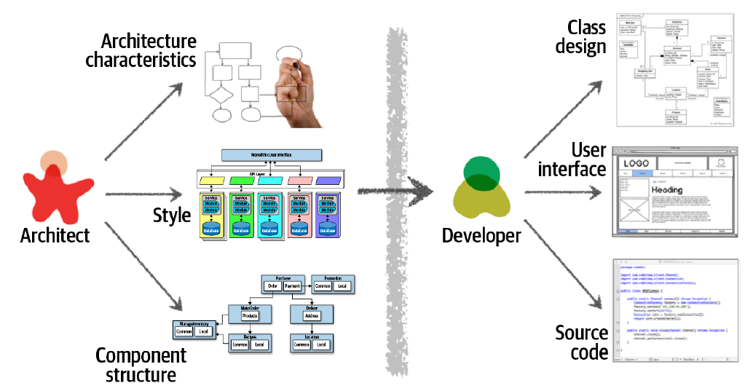
Architecture Versus Design

Slide 5
Software Architecture
consists of (1) the structure of the system (denoted as the heavy black lines supporting the architecture), combined with (2) architecture characteristics (“-ilities”) the system must support, (3) architecture decisions, and finally (4) design principles.

Slide 6
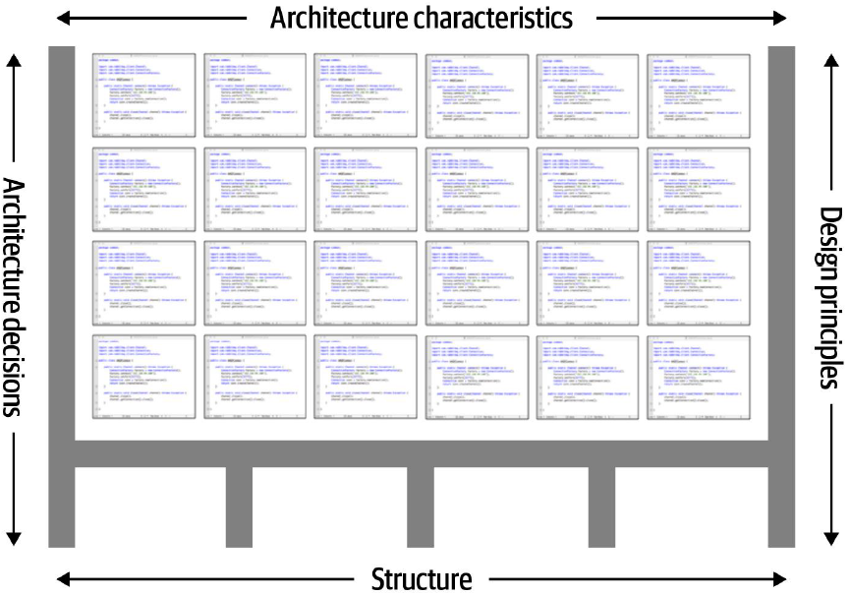
Software Architecture

Slide 7
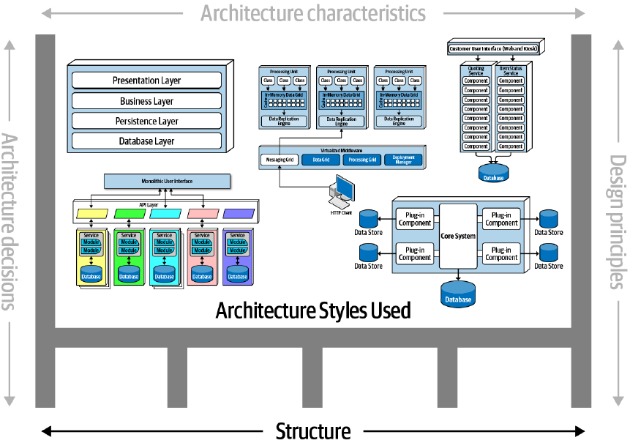
Software Architecture: Structure

Slide 8
Software Architecture: Structure
The structure of the system refers to the type of architecture style (or styles) the system is implemented in (such as microservices, layered, or microkernel).
The style does not wholly elucidate an architecture.
To fully describe an architecture, we need additional knowledge on the architecture characteristics, architecture decisions, and design principles

Slide 9
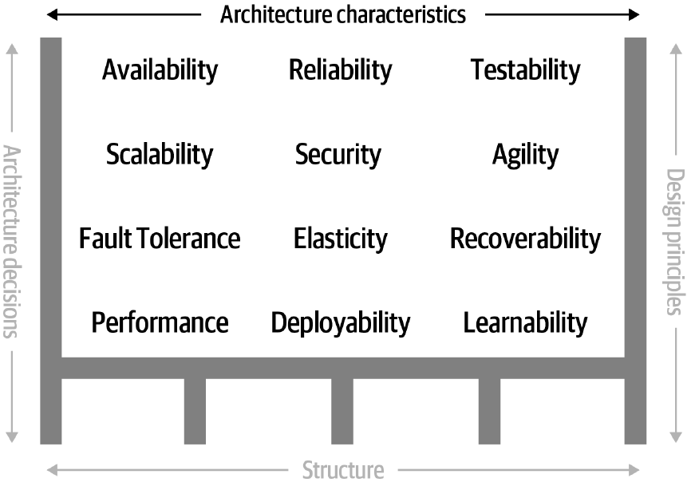
Software Architecture
The architecture characteristics define the success criteria of a system.

Slide 10
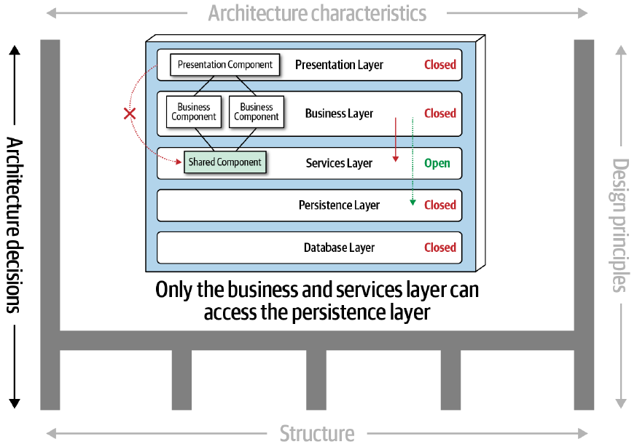
Software Architecture: Architecture Decisions

Slide 11
Software Architecture: Architecture Decisions
Architecture decisions define the rules for how a system should be constructed.
An architect might make an architecture decision that only the business and services layers within a layered architecture can access the database, restricting the presentation layer from making direct database calls.

Slide 12
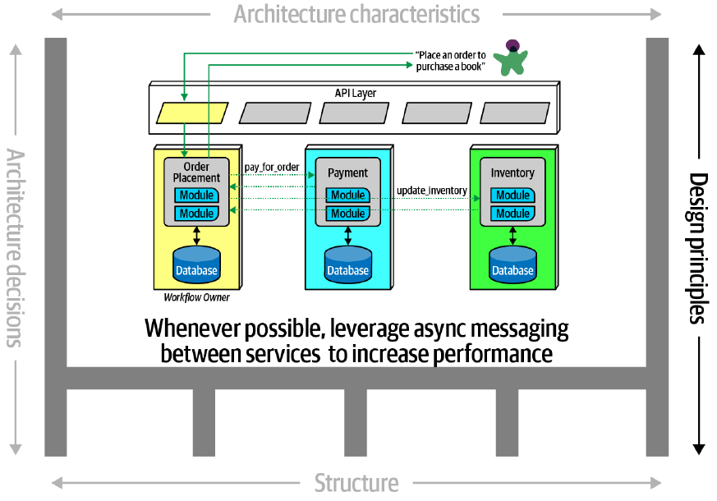
Software Architecture: Design Principles

Slide 13
Software Architecture : Design Principles
A design principle is a guideline rather than a hard-and-fast rule like an architecture decision.
The design principle may state that the development teams should leverage asynchronous messaging between services within a microservices architecture to increase performance.

Slide 14
Expectations of an Architect
Make architecture decisions
Continually analyze the architecture
Keep current with latest trends
Ensure compliance with decisions
Diverse exposure and experience
Have business domain knowledge
Possess interpersonal skills
Understand and navigate politics

Slide 15
Make Architecture Decisions
An architect is expected to define the architecture decisions and design principles used to guide technology decisions within the team, the department, or across the enterprise.

Slide 16
Continually Analyze the Architecture
An architect is expected to continually analyze the architecture and current technology environment and then recommend solutions for improvement.

Slide 17
Keep Current with Latest Trends
An architect is expected to keep current with the latest technology and industry trends.

Slide 18
Ensure Compliance with Decisions
An architect is expected to ensure compliance with architecture decisions and design principles.

Slide 19
Diverse Exposure and Experience
An architect is expected to have exposure to multiple and diverse technologies, frameworks, platforms, and environments.

Slide 20
Have Business Domain Knowledge
An architect is expected to have a certain level of business domain expertise.

Slide 21
Possess Interpersonal Skills
An architect is expected to possess exceptional interpersonal skills, including teamwork, facilitation, and leadership.

Slide 22
Understand and Navigate Politics
An architect is expected to understand the political climate of the enterprise and be able to navigate the politics.

Slide 23
Architecture and Engineering Practices
Software engineering practices refer to process-agnostic practices that have illustrated, repeatable benefit.
For example, continuous integration is a proven engineering practice that doesn’t rely on a particular process.
Adopting Agile engineering practices such as continuous integration makes building resilient architectures easier. It also illustrates how intertwined architecture has become with engineering practices.

Slide 24
Architecture and Operations/DevOps
The most obvious recent intersection between architecture and related fields occurred with the advent of DevOps.
Under a DevOps model, development and operations teams work together across the entire software application life cycle, from development and test through deployment to operations.

Slide 25
Architecture and Process
The process by which teams develop software has an impact on many facets of software architecture.
Architects in Agile projects can assume iterative development and therefore a faster feedback loop for decisions. That in turn allows architects to be more aggressive about experimentation and other knowledge that relies on feedback.

Slide 26
Architecture and Data
A large percentage of serious application development includes external data storage, often in the form of a relational (or, increasingly, NoSQL) database.
Database administrators often work alongside architects to build data architecture for complex systems, analyzing how relationships and reuse will affect a portfolio of applications.

Slide 27
Laws of Software Architecture
Everything in software architecture is a trade-off.
If an architect thinks they have discovered something that isn't a trade-off, more likely they just haven't identified the trade-off yet.
Why is more important than how.

Slide 28
Architectural Thinking
Four main aspects of thinking like an architect
Understand the difference between architecture and design and know how to collaborate with development teams to make architecture work
Have a wide breadth of technical knowledge while still maintaining a certain level of technical depth, allowing the architect to see solutions and possibilities that others do not see
Understand, analyze, and reconcile trade-offs between various solutions and technologies.
Understand the importance of business drivers and how they translate to architectural concerns

Slide 29
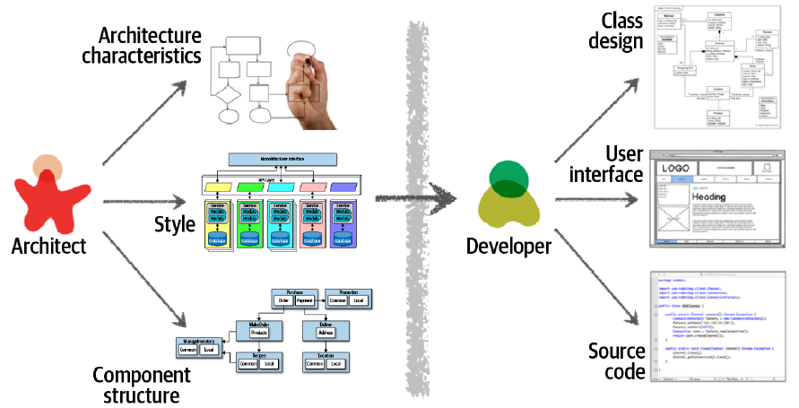
Architectural Thinking
Architecture and Design

Slide 30
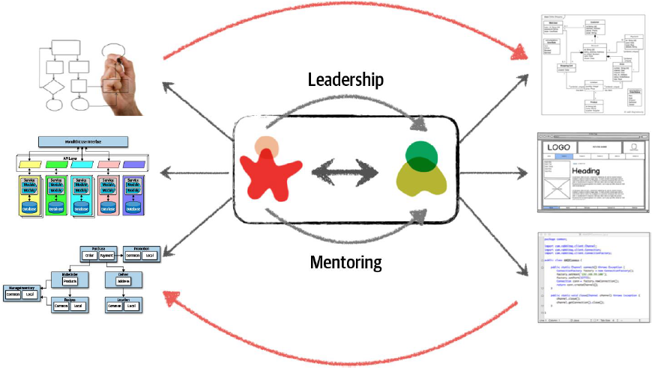
Architectural Thinking
Making architecture work through collaboration

Slide 31
Architectural Thinking
Four main aspects of thinking like an architect
Understand the difference between architecture and design and know how to collaborate with development teams to make architecture work
Have a wide breadth of technical knowledge while still maintaining a certain level of technical depth, allowing the architect to see solutions and possibilities that others do not see
Understand, analyze, and reconcile trade-offs between various solutions and technologies.
Understand the importance of business drivers and how they translate to architectural concerns

Slide 32
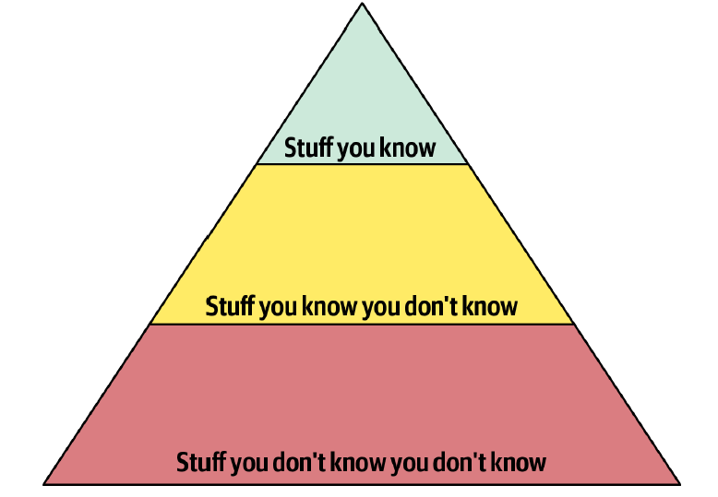
Architectural Thinking
Technical Breadth
The pyramid representing all knowledge

Slide 33
Architectural Thinking
Technical Breadth

Slide 34
Architectural Thinking
Technical Breadth

Slide 35
Architectural Thinking
Technical Breadth

Slide 36
Architectural Thinking
Four main aspects of thinking like an architect
Understand the difference between architecture and design and know how to collaborate with development teams to make architecture work
Have a wide breadth of technical knowledge while still maintaining a certain level of technical depth, allowing the architect to see solutions and possibilities that others do not see
Understand, analyze, and reconcile trade-offs between various solutions and technologies.
Understand the importance of business drivers and how they translate to architectural concerns

Slide 37
Architectural Thinking
Analyzing Trade-Offs
See trade-offs in every solution, technical or otherwise, and analyzing those trade-offs to determine what is the best solution
Architecture is the stuff you can’t Google
There are no right or wrong answers in architecture—only trade-offs.

Slide 38
Architectural Thinking
An Example of Trade-Offs: Queues or Topics?
Let’s consider an item auction system where someone places a bid for an item up for auction.
The Bid Producer service generates a bid from the bidder and then sends that bid amount to the Bid Capture, Bid Tracking, and Bid Analytics services. This could be done by using queues in a point-to-point messaging fashion or by using a topic in a publish-and-subscribe messaging fashion.

Slide 39
Architectural Thinking
An Example of Trade-Offs: Queues or Topics?

Slide 40
Architectural Thinking
An Example of Trade-Offs: Queues or Topics?
Use of a topic in a publish-and-subscribe messaging model

Slide 41
Architectural Thinking
An Example of Trade-Offs: Queues or Topics?
Use of queues in a point-to-point messaging model

Slide 42
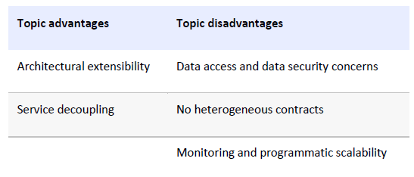
Architectural Thinking
An Example of Trade-Offs: Queues or Topics?
Which is the better option? And the answer? It depends!
Which is more important: extensibility or security?

Slide 43
Architectural Thinking
Four main aspects of thinking like an architect
Understand the difference between architecture and design and know how to collaborate with development teams to make architecture work
Have a wide breadth of technical knowledge while still maintaining a certain level of technical depth, allowing the architect to see solutions and possibilities that others do not see
Understand, analyze, and reconcile trade-offs between various solutions and technologies.
Understand the importance of business drivers and how they translate to architectural concerns

Slide 44
Architectural Thinking
Understanding Business Drivers
Thinking like an architect is understanding the business drivers that are required for the success of the system and translating those requirements into architecture characteristics (such as scalability, performance, and availability).

Slide 45
Architectural Thinking
Understanding Business Drivers
Business stakeholder
User satisfaction
Time to market
Mergers and acquisitions
Competitive advantage
Regulatory Compliance

Slide 46
Architectural Thinking
Understanding Business Drivers
Software architect
Performance
Fault tolerance
Agility
Extensibility
Scalability
Other “ilities”

Slide 47
Architectural Thinking Understanding Business Drivers
Business stakeholder
Software architect
User satisfaction
Performance
Availability
Fault tolerance
Testability
deployability
Agility

Slide 48
Architectural Thinking Understanding Business Drivers
Business stakeholder
Software architect
Time to market
Agility
Testability
Deployability

Slide 49
Architectural Thinking
Understanding Business Drivers
Translating business requirements into architecture characteristics (such as scalability, performance, and availability) is a challenging task
It requires the architect to have (1) some level of business domain knowledge and (2) healthy, collaborative relationships with key business stakeholders.

Slide 50
Reference
Fundamentals of Software Architecture: An Engineering Approach. Mark Richards and Neal Ford (2020): O’REILLY
Chapter 1 and 2

